Slide 1
Practical Presentation– Air Quality Prediction using Machine Learning
By Vishvesh Kadam

Slide 2
INTRODUCTION
Air pollution, an ever growing problem in modern world
Air Quality Index, a prime indicator of air pollution.
Time Series – A sequence of data points measured at constant time interval over a period of time.
Forecasting can alarm people of severe air quality in advance.

Slide 3
PROJECT BACKGROUND
Annual costs estimated to be more than $5 trillion
Major pollutants: PM2.5, NO2, SO2, CO, O3, NH3.
In Delhi, the mean concentration of PM2.5 is fifteen times higher than WHO guideline.
So the prediction of air quality in such places is of prime importance.
Notes:
Today, there are many areas of the world where the public is exposed to unhealthy levels of air pollutants
The annual costs from air pollution related illness are estimated to be more than $5 Trillion according to the new World Bank report.
Major pollutants in air are: Particulate Matter (size less than 2.5 µm) PM2.5, NO2, SO2, CO, ozone(O3), Ammonia(NH3).
Three techniques used to anticipate any pollutant like PM2.5 are statistical models, chemical transport, and machine learning.
Machine learning strategy outperform the other two methods.
In Delhi, the mean concentration of PM2.5 for past 3 years is around 150 µg/m³, which is fifteen times higher than WHO guideline.
So the prediction of air quality in such places is of prime importance.

Slide 4
PREVIOUS RESEARCH
Popular data source – Central pollution control board (Delhi): cpcb.nic.in
Univariate forecasting of PM10, PM2.5 or AQI. Multivariate forecasting based on PM2.5, SO2, NO2, CO, Ozone, etc.
Common Models: ARIMA, VARMA, MLP and SVR.
Hybrid models using Neural Network and ARIMA.
Common Evaluation method: Mean Absolute Percentage Error(MAPE)

Slide 5
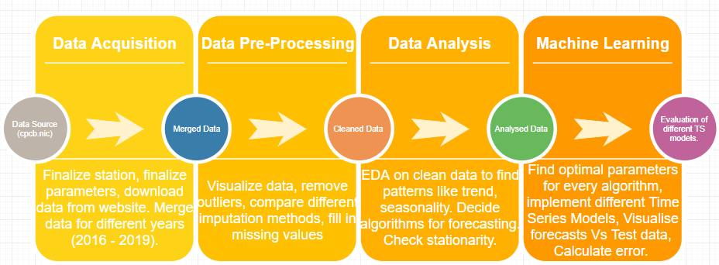
RESEARCH PLAN

Slide 6
DATASET
Data sourced from http://cpcb.nic.in/.
Various options to filter data.
Station - ‘Anand Vihar’.
Time Range – Jan, 2016 – June,2019.
Time Interval – 1 hour.
Parameters – PM2.5, NH3, NO2, SO2, CO.
Total points: 30624 (8760 in a year)

Slide 7
DATA CLEANING
Main Challenge - handling missing values.
More than 20% data missing every year.
Lot of fluctuations in data with some outliers.
To deal with these problems, below steps were taken:
Implement various imputation model on sample data and evaluate better imputing model.
Decide data boundaries.
Impute previous year values.
Apply best imputation model on new cleaned data.

Slide 8
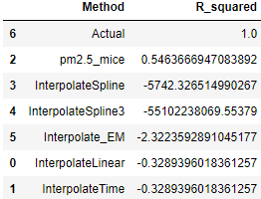
DATA CLEANING
Imputation Model evaluation:
Key points:
Some models like KNN, moving window, could not work with large chunks of missing data.
EM – extreme results (negative values)
Other simple models – single value.
MICE :
Could impute dynamic values.
Work well on large missing chunk.
Constraint- Works only with multivariate values.

Slide 9
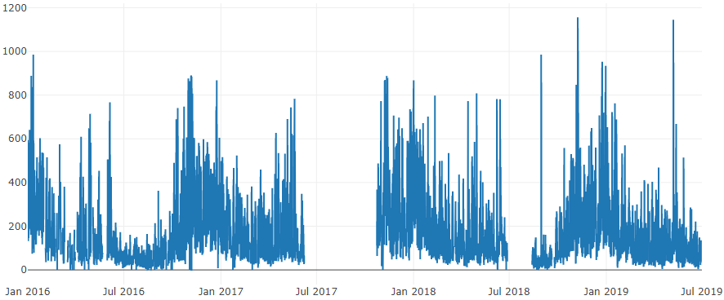
DATA CLEANING
Original Dataset: PM2.5
Missing at Random (MAR)
Outliers – values above 800 and some negative values.
Seasonality: Higher values at start and end of each year. Lowest values during mid-year. Follow similar pattern across different years.

Slide 10
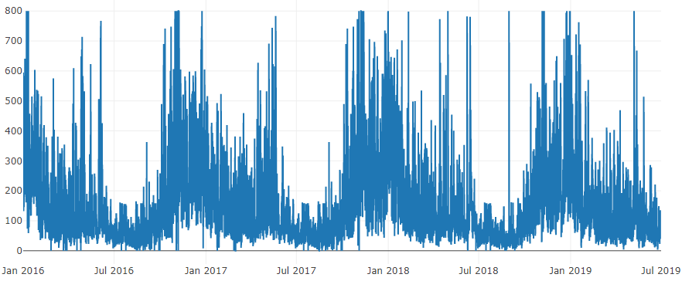
DATA CLEANING
Processed Dataset: PM2.5
Replaced negative and extreme high values.
Replaced null values with previous year non-null values.
Applied MICE imputation on remaining null values.

Slide 11
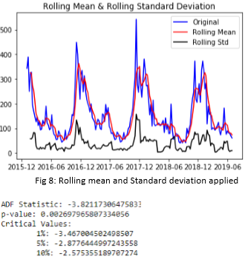
DATA ANALYSIS
STATIONARITY: Data should follow constant mean and variance over time.
Dickey-fuller test:
null hypothesis: the time series is non- stationary
Test statistics is less than 1% critical values. Hence, data is now 99% stationary.
FEATURE EXTRACTION: For performing regression models, time features like Week, Month were extracted.

Slide 12
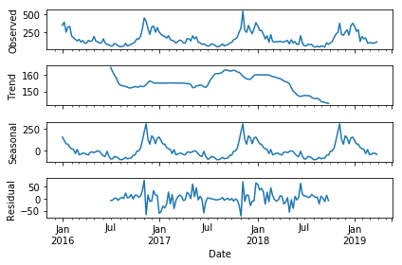
DATA ANALYSIS
Time series data decomposition:
No clear trend. Strong seasonality.

Slide 13
MODEL IMPLEMENTATION
Time series model:
Simple Exponential Smoothing(SES).
Auto Regressive Integrated Moving Average (ARIMA) Models:
Simple/Auto ARIMA
Recursive ARIMA
Seasonal ARIMA (SARIMAX)
Holt Winter
Regression model:
Support Vector Regressor
K-nearest neighbor (KNN)

Slide 14
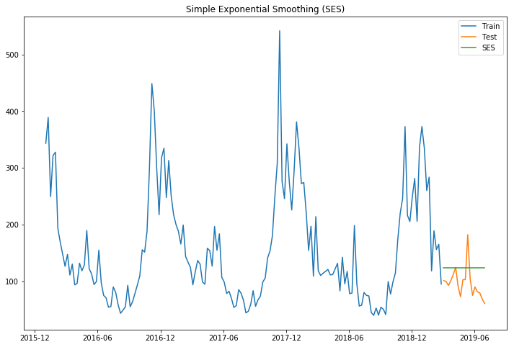
MODEL IMPLEMENTATION
Simple Exponential Smoothing(SES): Takes into consideration all the data while weighing the data points differently.
So, the equation for SES:
where 0≤ α ≤1 is the smoothing parameter.

Slide 15
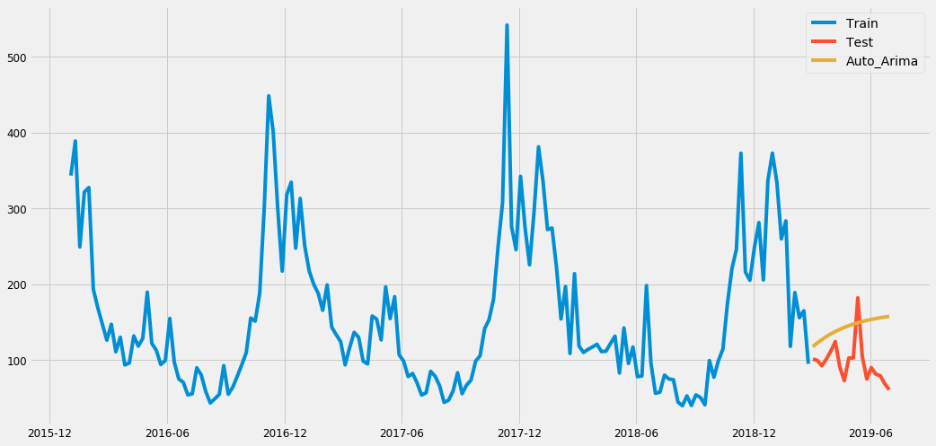
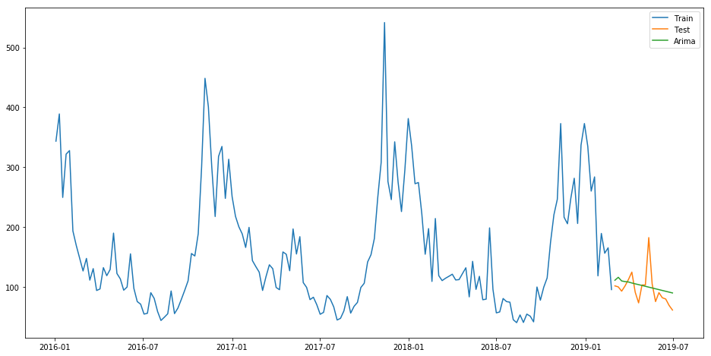
MODEL IMPLEMENTATION
ARIMA- Key parts of ARIMA Model:
p: the lag order.
d: order of differencing.
q: the order for moving average.
Auto-Arima automatically calculates p,d,q values and then applies these values to forecast.
To determine best values for p, d and r; (Akaike Information Criterion) AIC values were used.

Slide 16
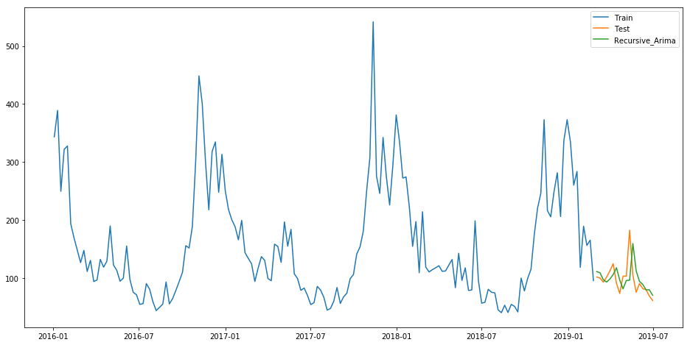
MODEL IMPLEMENTATION
Recursive ARIMA - Predicting for very next day.
Powerful: Gives better results for long term forecasting.
More computational time.

Slide 17
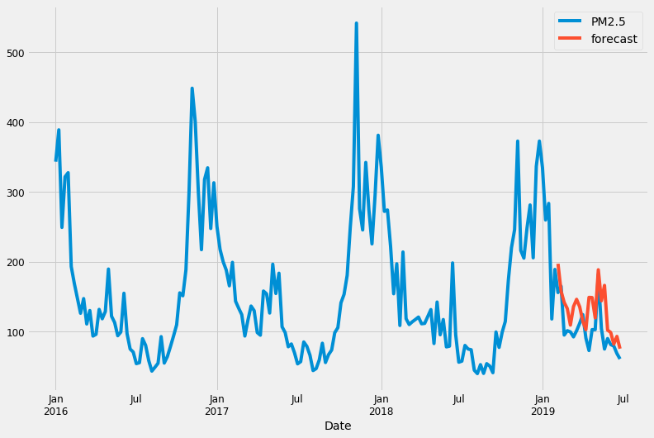
MODEL IMPLEMENTATION
Seasonal ARIMA – Takes seasonality into consideration
Gives better results based on seasonality
Overhead of computing seasonal p, d, q

Slide 18
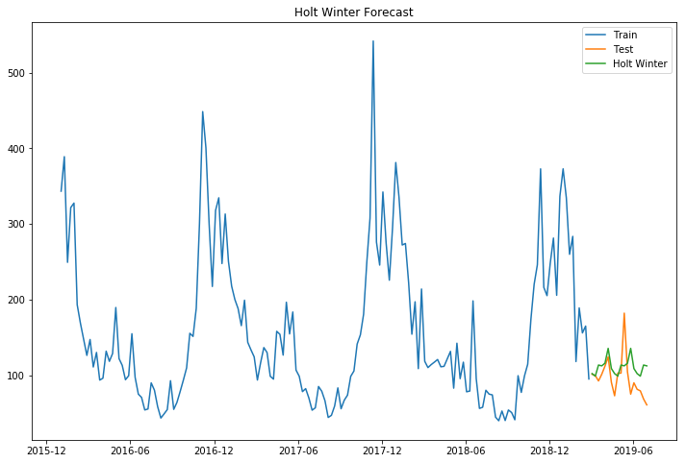
MODEL IMPLEMENTATION
HOLT WINTER– Like SARIMAX, suited for data with seasonality.
Triple Exponential smoothing
Can execute both additive and multiplicative technique.

Slide 19
MODEL IMPLEMENTATION
Support Vector Regressor– Creates an optimal line (hyperplane) which classifies new sample based on given labeled training dataset
Target is to adjust the hyperplane such that most of the points lie within the threshold of the line.
K-Nearest Neighbor (KNN)– Works on the notion that similar type of values are close to each other.
Goal is to calculate how far other values are from the current value

Slide 20
MODEL IMPLEMENTATION
Evaluation Methods:
Mean Absolute Percentage Error (MAPE)
Root Mean Square Error (RMSE)
Model | RMSE | MAPE
Simple Exponential Smoothing (SES) | 37 | 38
Auto-ARIMA | 50 | 55
ARIMA | 38 | 34
Recursive ARIMA | 24 | 22
Seasonal ARIMA | 35 | 32
Holt-Winter | 31 | 30
SVR | 38 | 33
KNN | 30 | 29

Slide 21
QUESTIONS?

